Slide 1
RNA-Seq QC
Updated 6/20/2019
RNA-Seq data from 6 plates
Hufford Lab

Slide 2
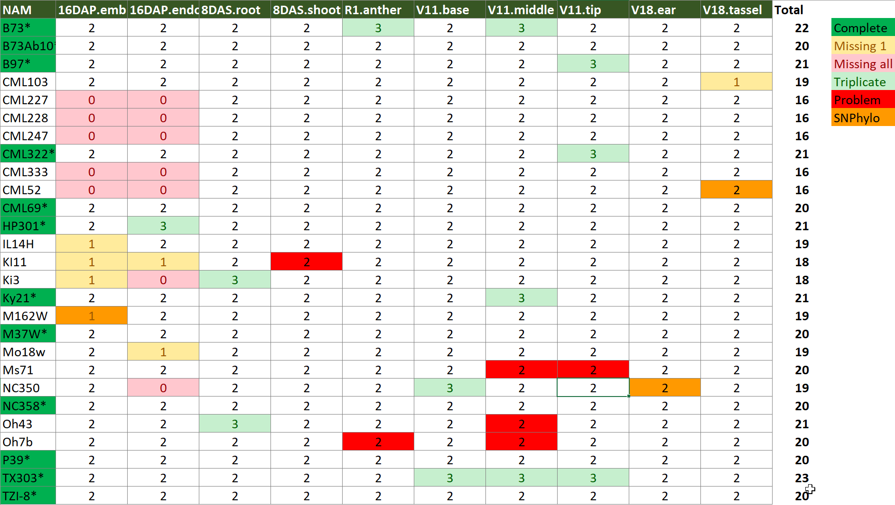
Overview

Slide 3
Samples with <10x effective coverage
NAM | Sample | ID | TotalReads | TotalMapped | TotalMapped% | Coverage | EffCoverage
CML322 | V11_tip | MN08052 | 609 | 98 | 16.1% | 0.0% | 0.0%
KI11 | 8DAS_shoot | MN14022 | 2,221 | 410 | 18.5% | 0.0% | 0.0%
HP301 | 16DAP_endosperm | MN12091 | 1,353,351 | 10,614 | 0.8% | 1.2% | 0.0%
TX303 | V11_middle | MN26042 | 20,214,210 | 1,725,890 | 8.5% | 18.1% | 1.2%
Oh7b | V11_middle | MN24041 | 9,965,430 | 4,305,184 | 43.2% | 8.9% | 3.2%
Oh43 | 8DAS_root | MN23011 | 10,038,758 | 5,093,680 | 50.7% | 9.0% | 3.8%
B73 | V11_middle | MN01041 | 21,971,828 | 7,699,399 | 35.0% | 19.6% | 6.3%
Oh7b | R1_anther | MN24081 | 8,908,083 | 7,691,551 | 86.3% | 8.0% | 6.4%
Ki3 | 8DAS_root | MN15011 | 9,088,278 | 8,283,672 | 91.1% | 8.2% | 7.1%
Ms71 | V11_tip | MN20051 | 20,725,925 | 10,024,683 | 48.4% | 18.5% | 7.4%
Oh43 | V11_middle | MN23041 | 17,266,642 | 10,088,219 | 58.4% | 15.4% | 7.6%
NC350 | V11_base | MN21032 | 12,128,335 | 10,583,721 | 87.3% | 10.8% | 9.0%
TX303 | V11_base | MN26031 | 12,292,732 | 11,013,458 | 89.6% | 11.0% | 9.3%
Ms71 | V11_middle | MN20041 | 16,545,782 | 11,904,622 | 71.9% | 14.8% | 9.3%
B97 | V11_tip | MN03052 | 13,200,800 | 11,490,846 | 87.0% | 11.8% | 9.5%
re-sequenced

Slide 4
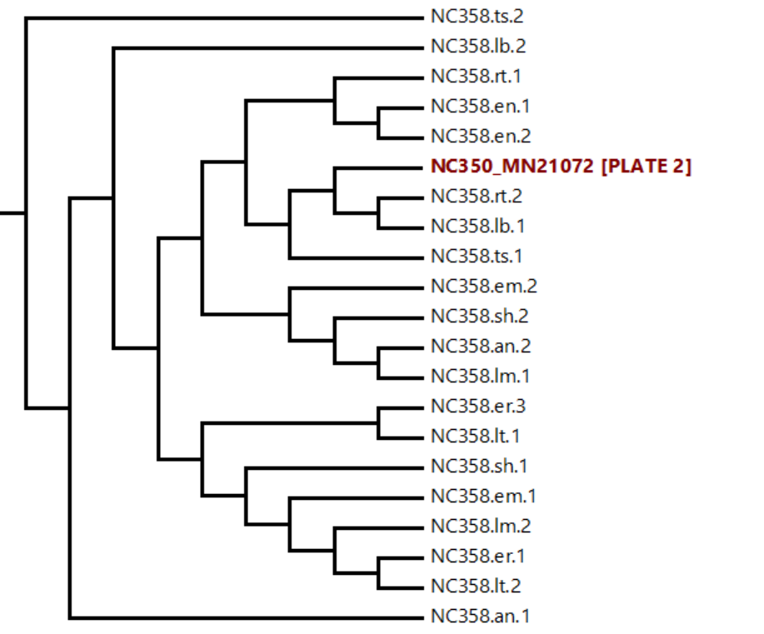
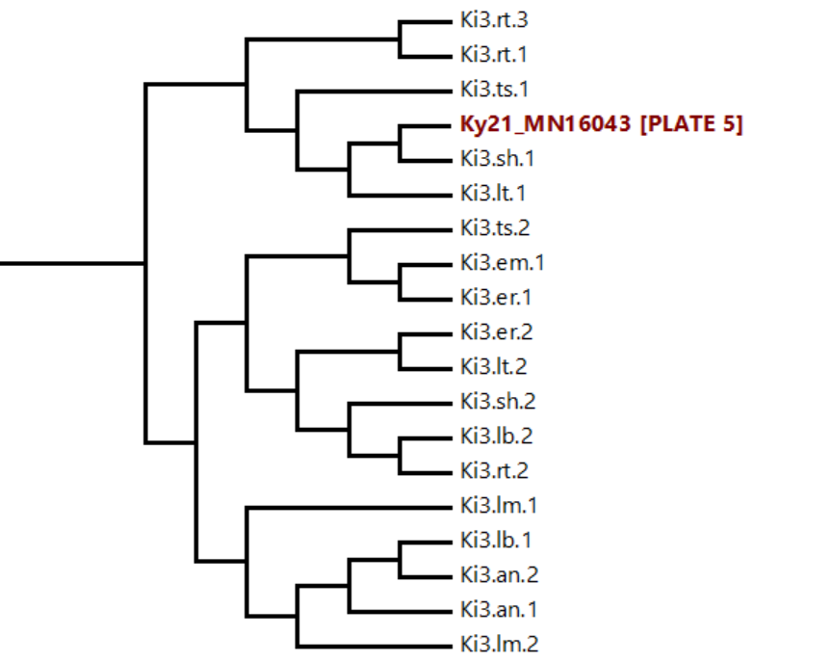
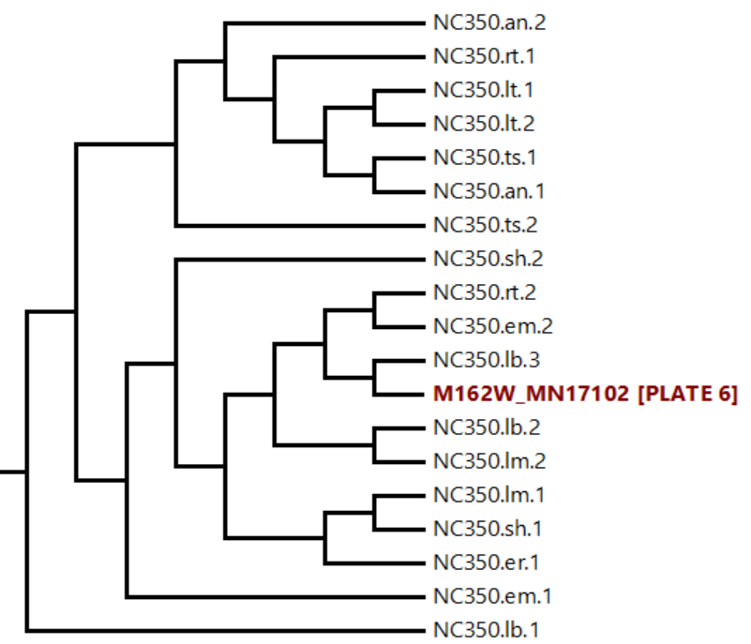
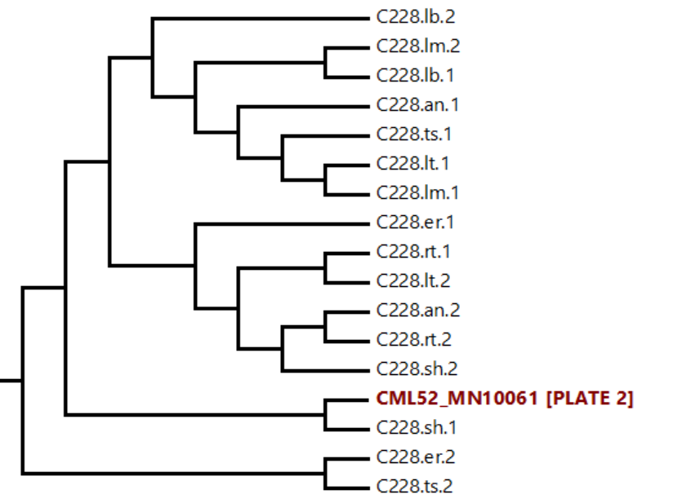
Inconsistently Clustering Samples
NAM | Sample | ID | TotalReads | TotalMapped | TotalMapped% | Coverage | EffCoverage
NC350 | V18_ear | MN21072 | 28,369,086 | 25,245,024 | 89.0% | 25.3% | 21.3%
M162W | 16DAP_embryo | MN17102 | 19,379,156 | 14,872,686 | 76.7% | 17.3% | 10.8%
CML52 | V18_tassel | MN10061 | 30,384,626 | 26,743,955 | 88.0% | 27.1% | 22.6%
Ky21 | V11_middle | MN16043 | 33,684,726 | 28,642,044 | 85.0% | 30.1% | 23.7%
re-sequenced

Slide 5
Summary

Slide 6
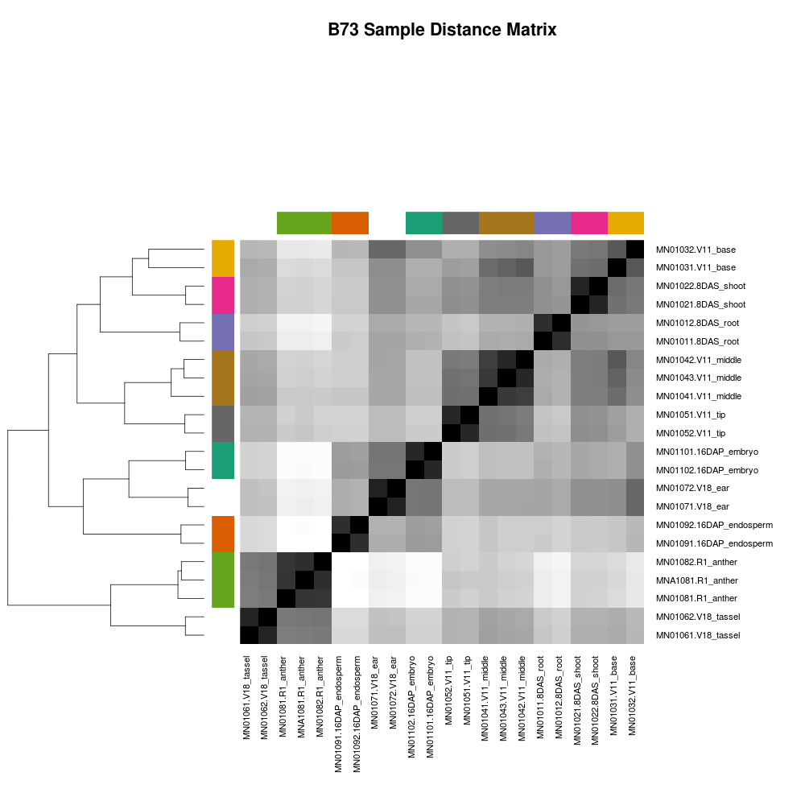
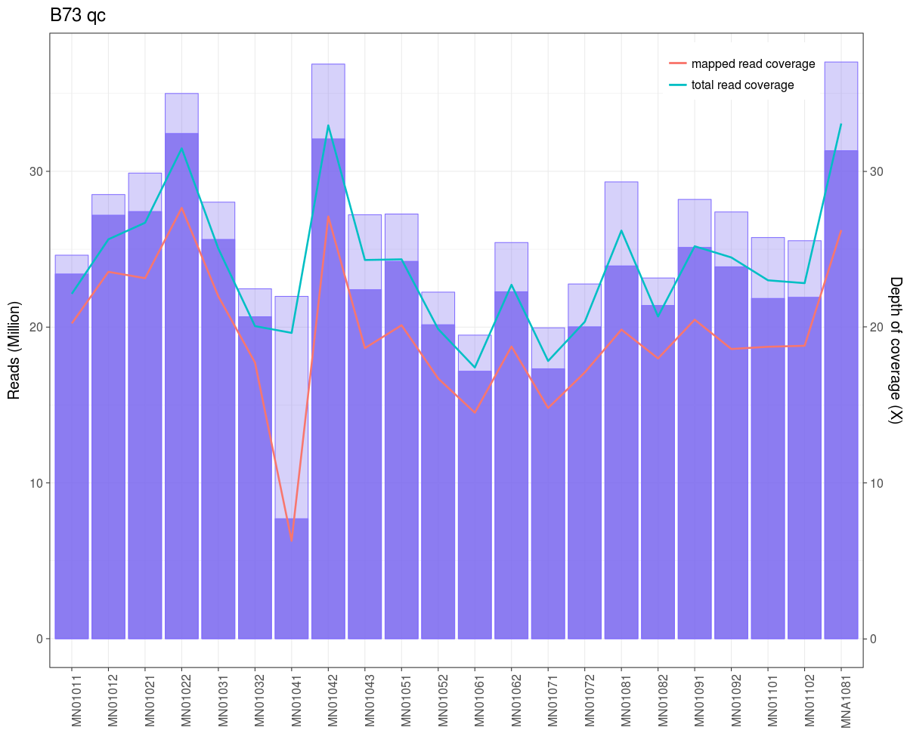
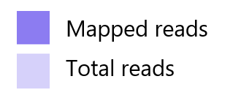

Slide 7
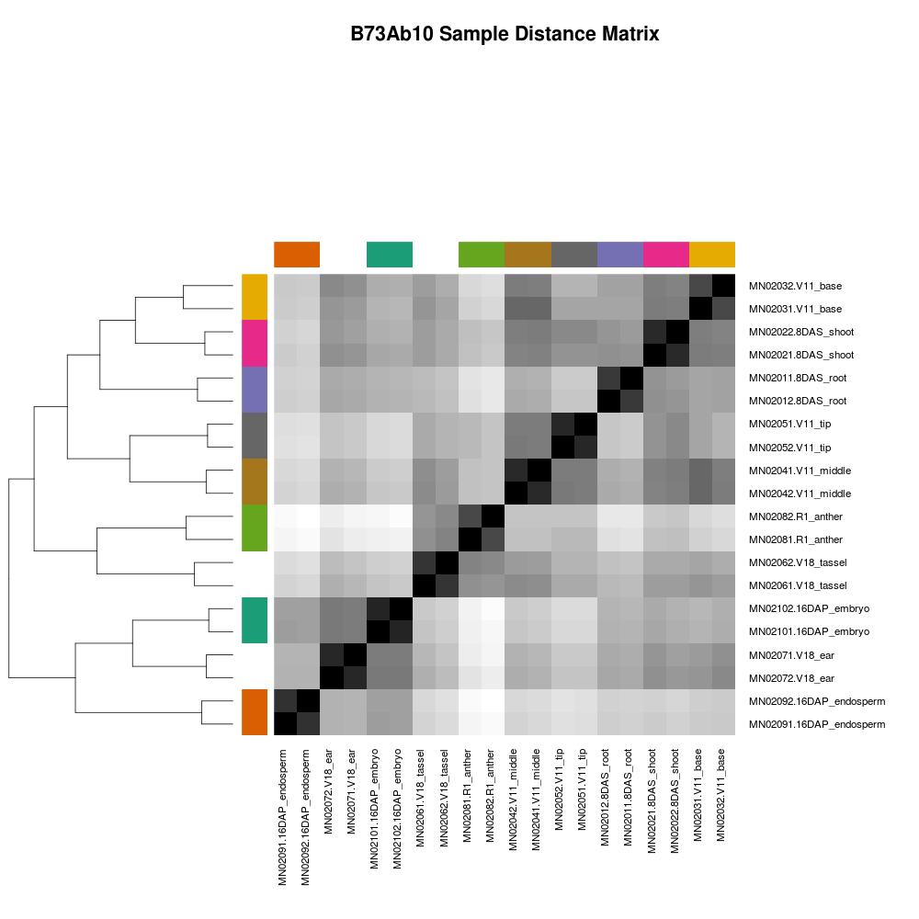
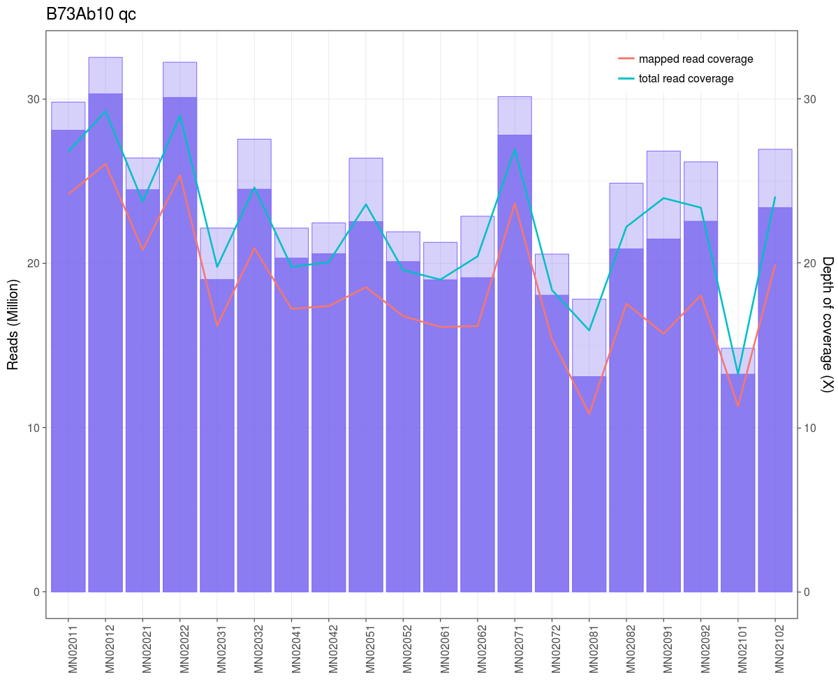

Slide 8
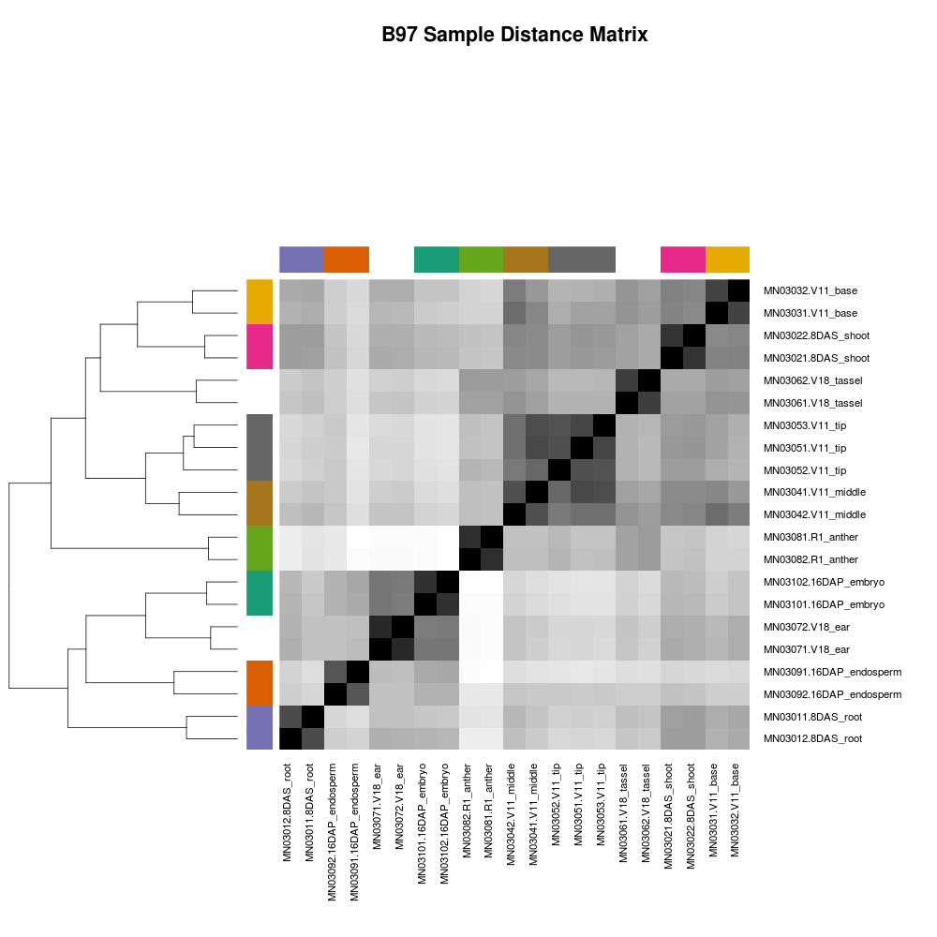
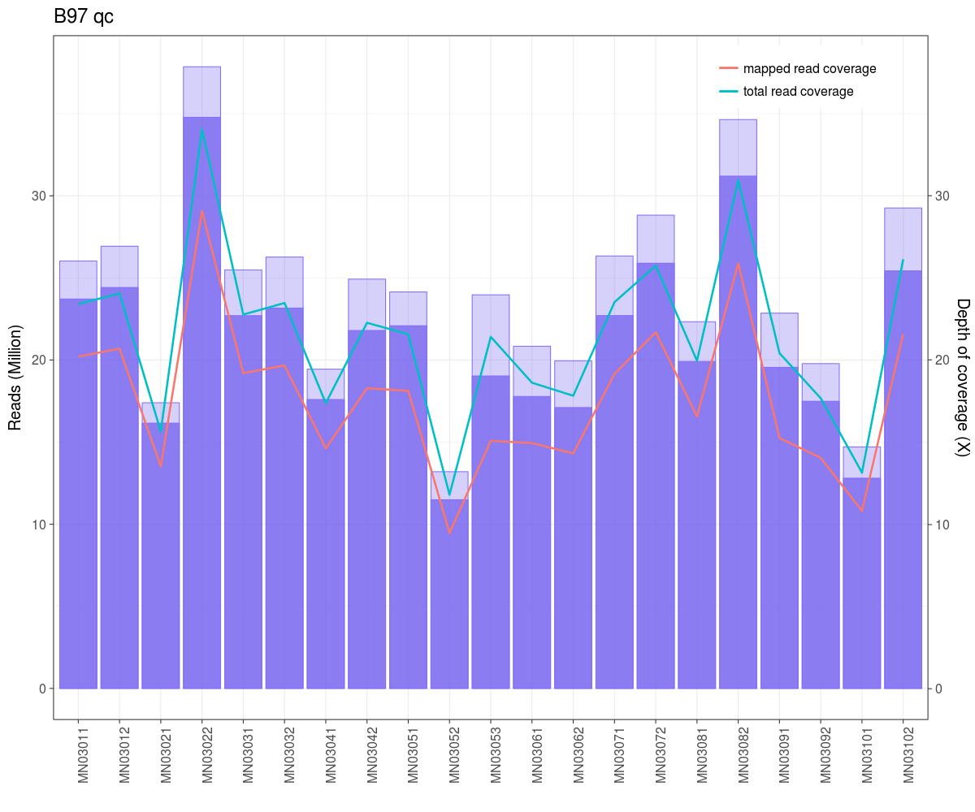

Slide 9
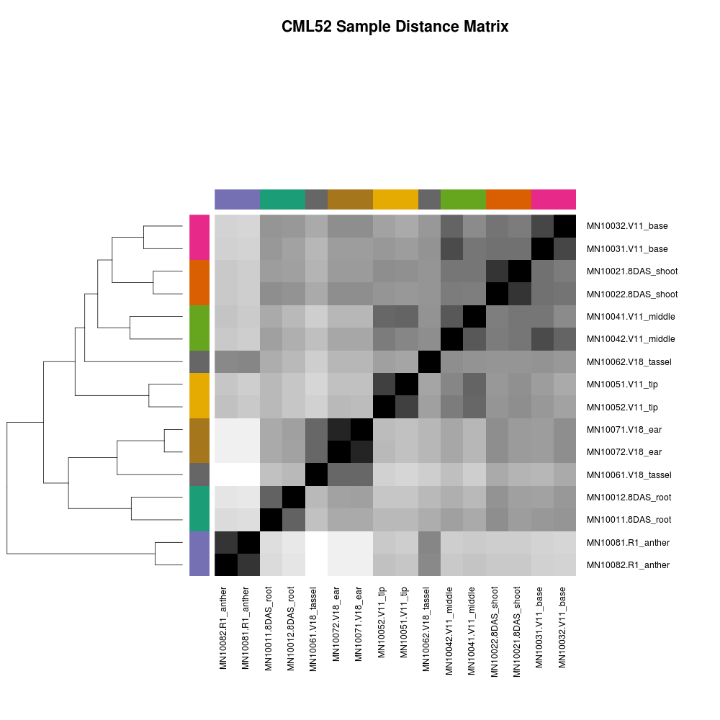
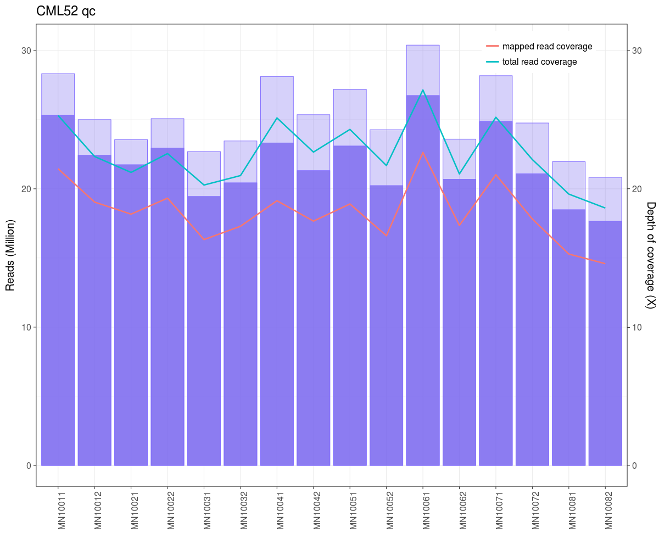

Slide 10
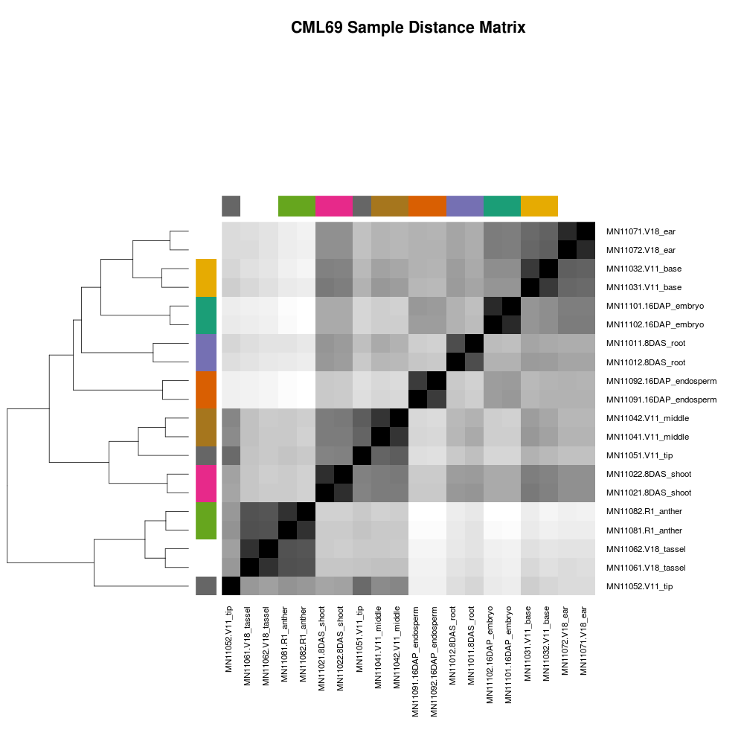
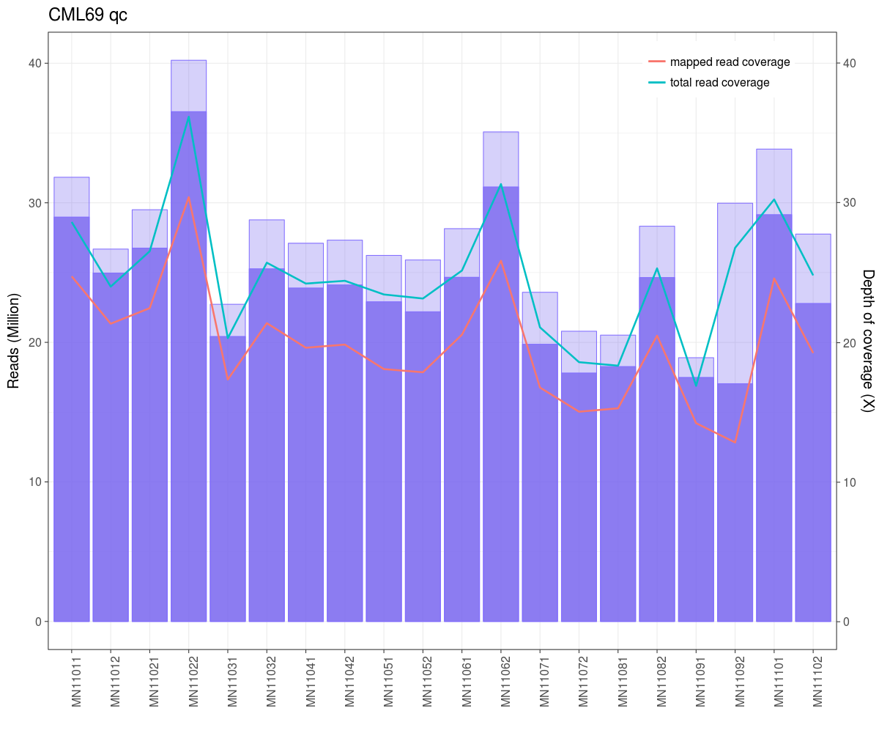

Slide 11
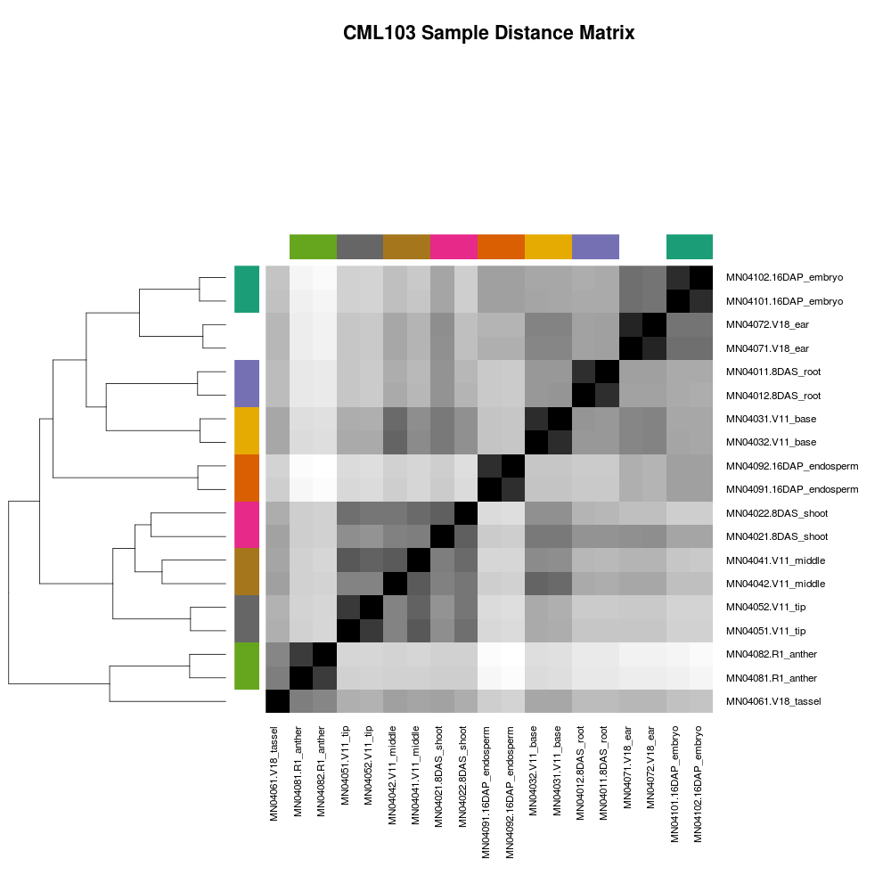
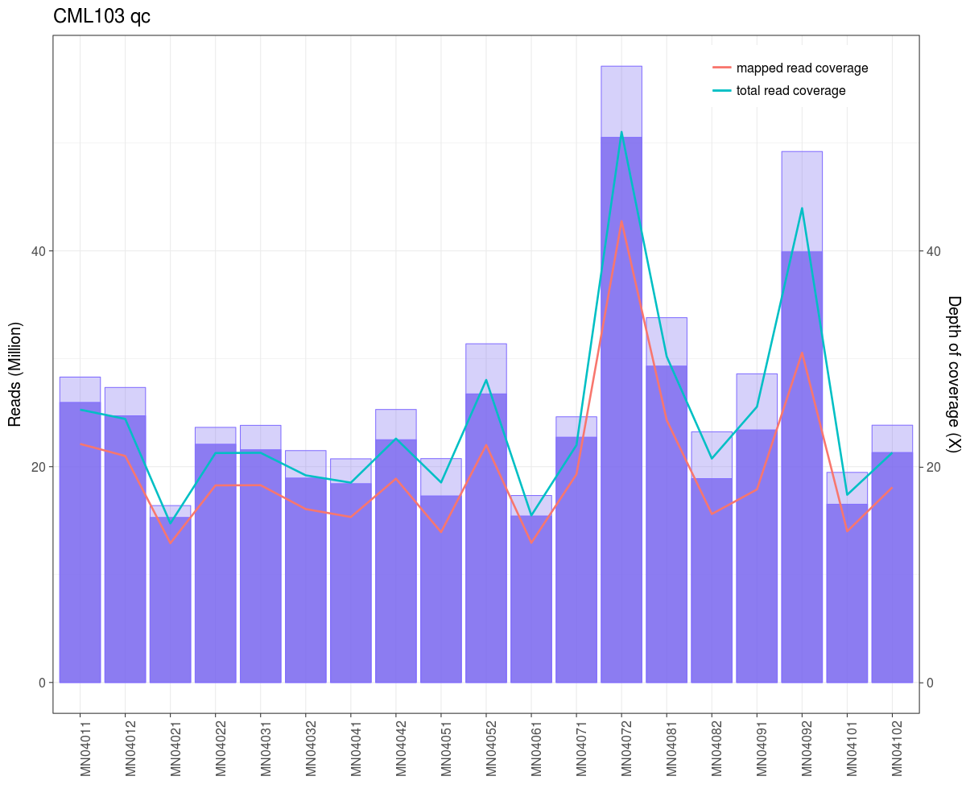

Slide 12
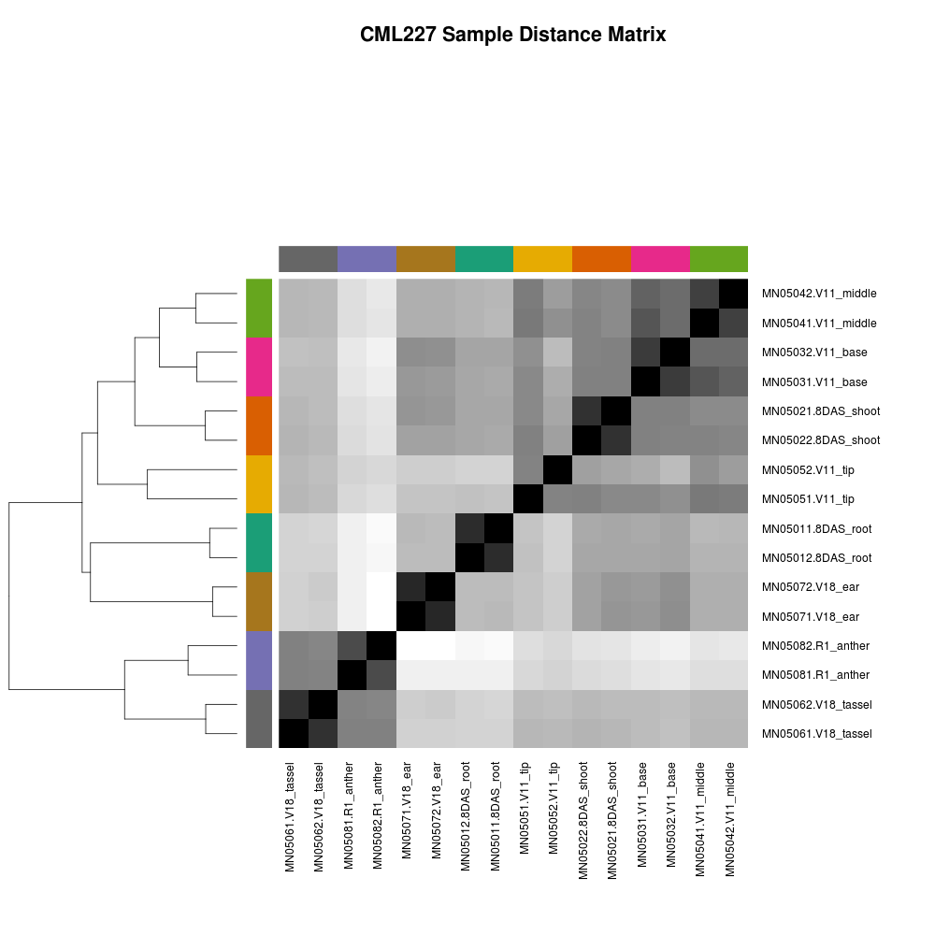
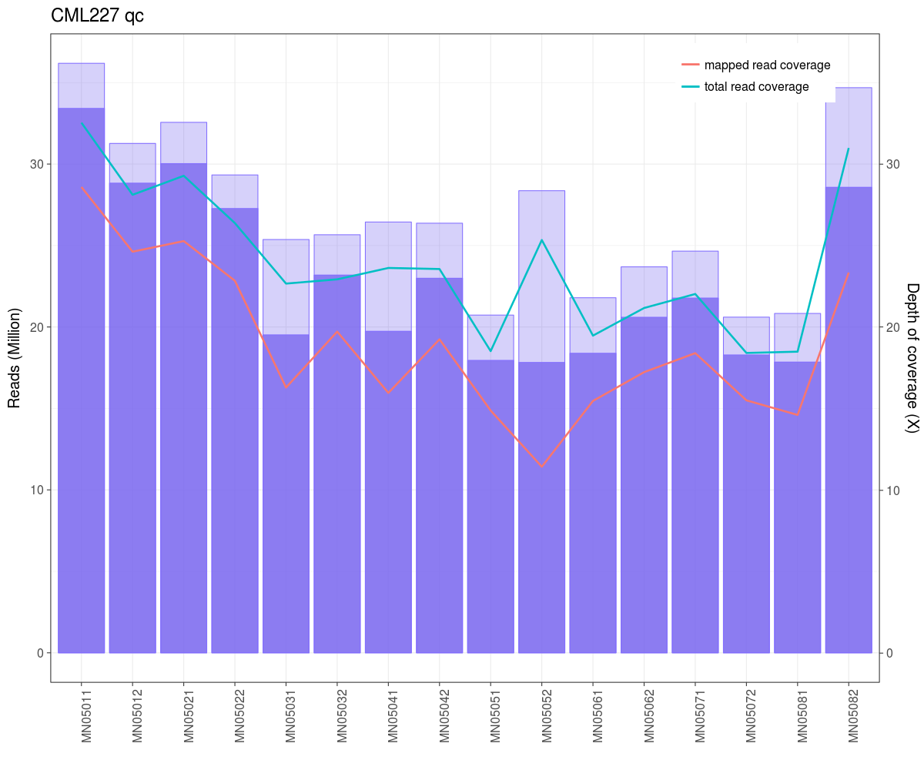

Slide 13
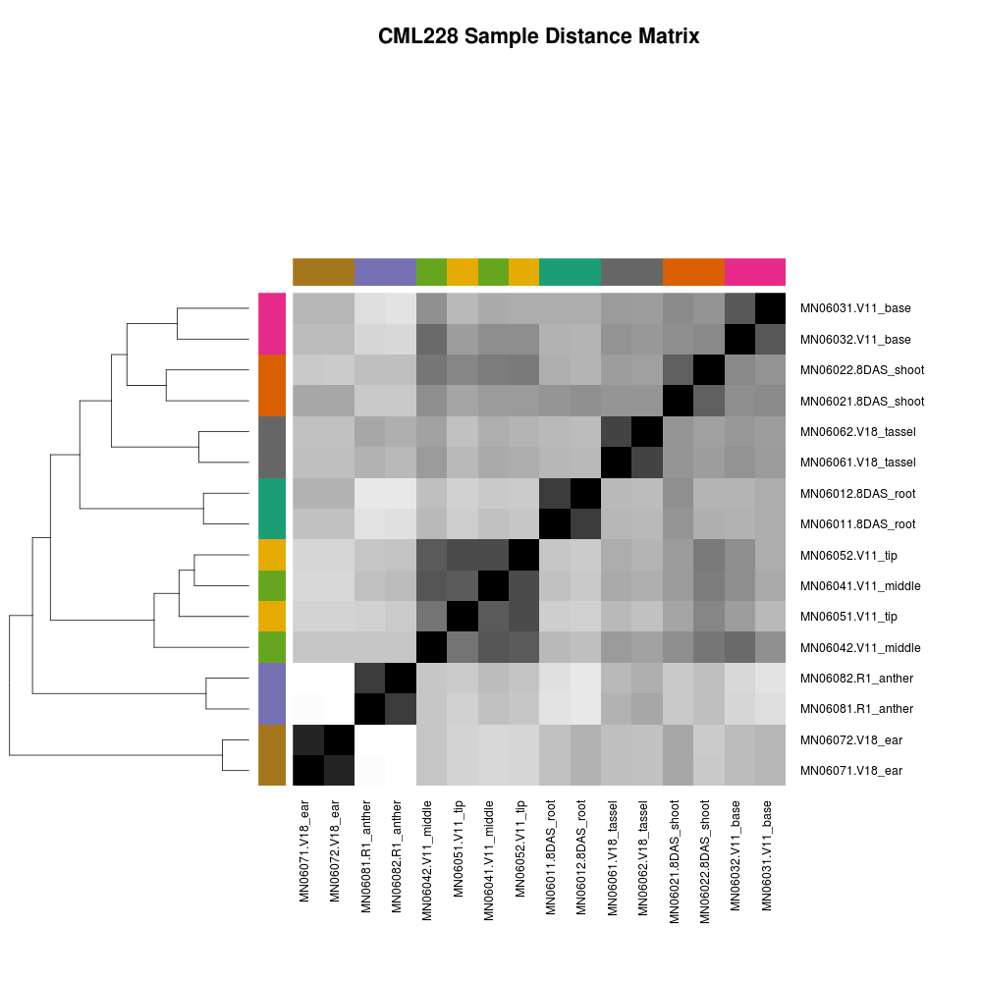
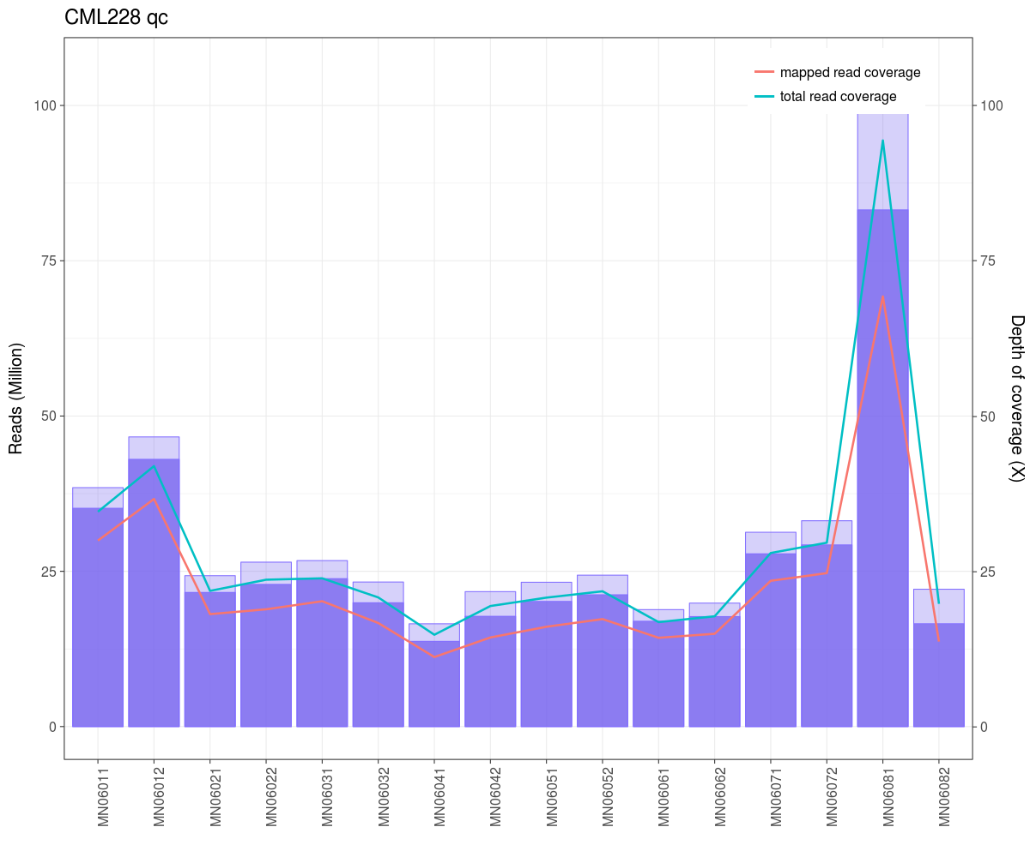

Slide 14
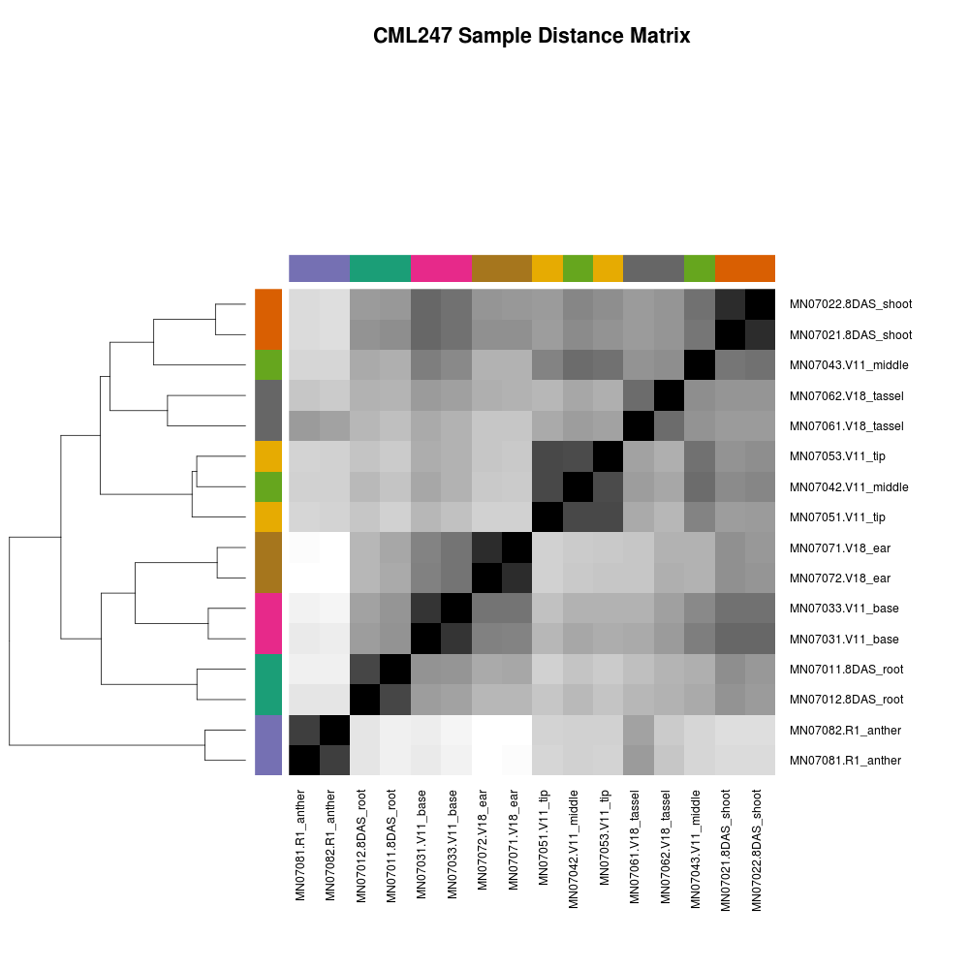
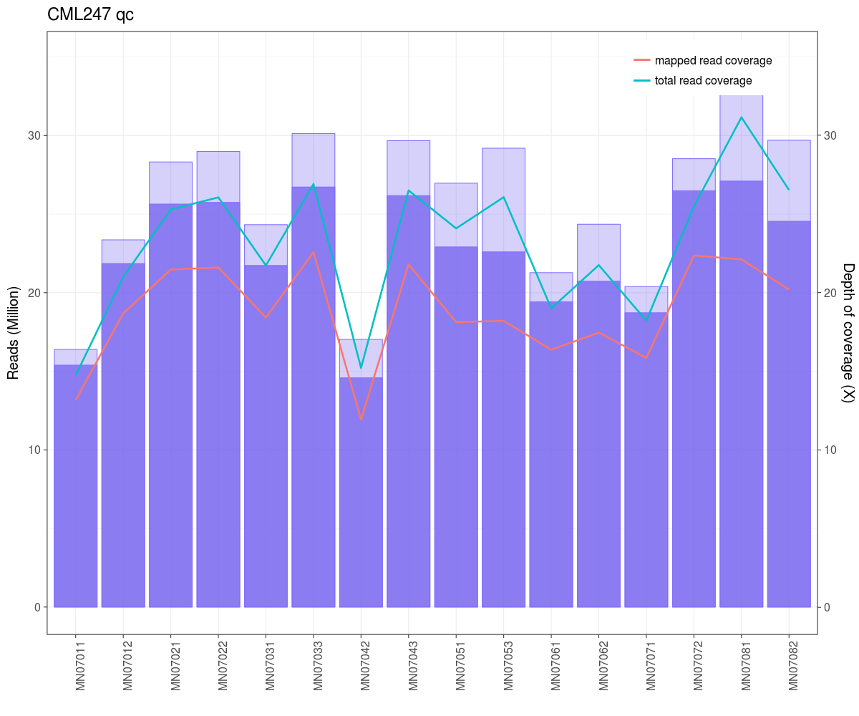

Slide 15
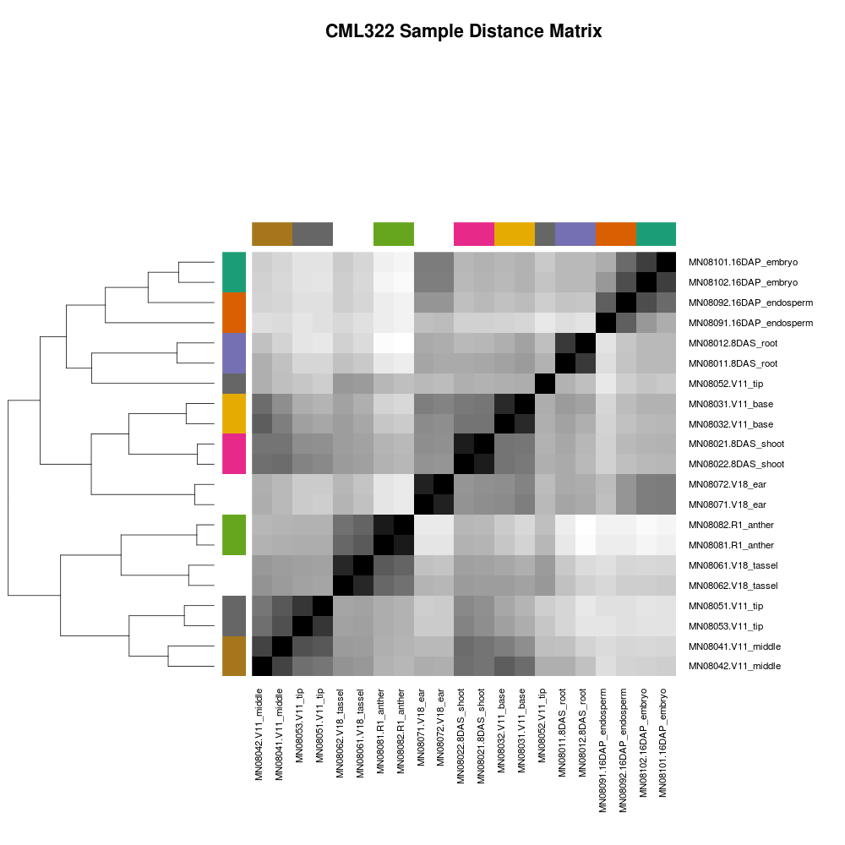
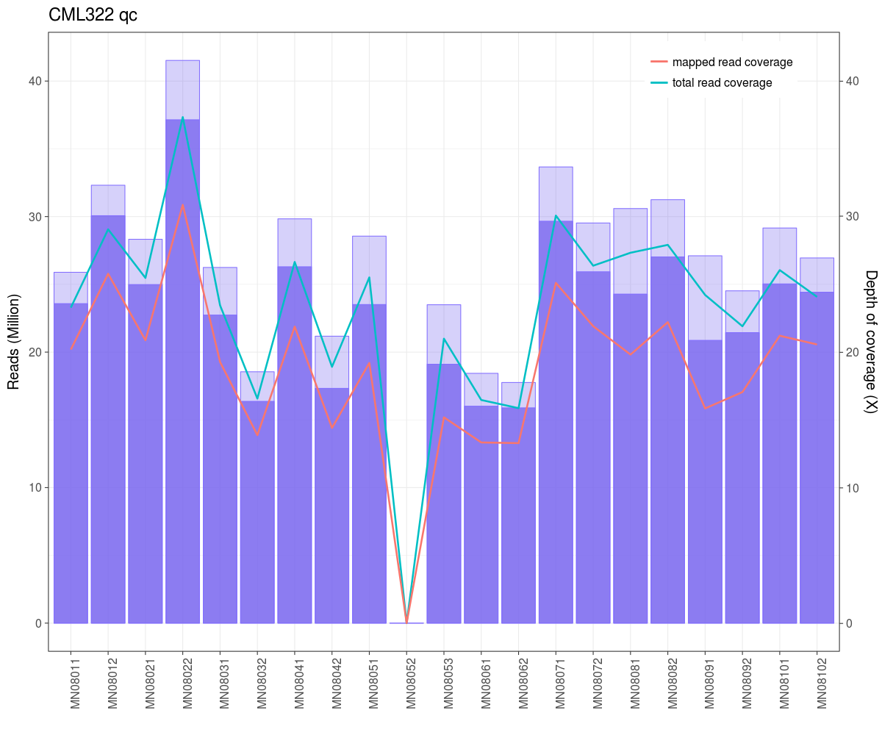

Slide 16
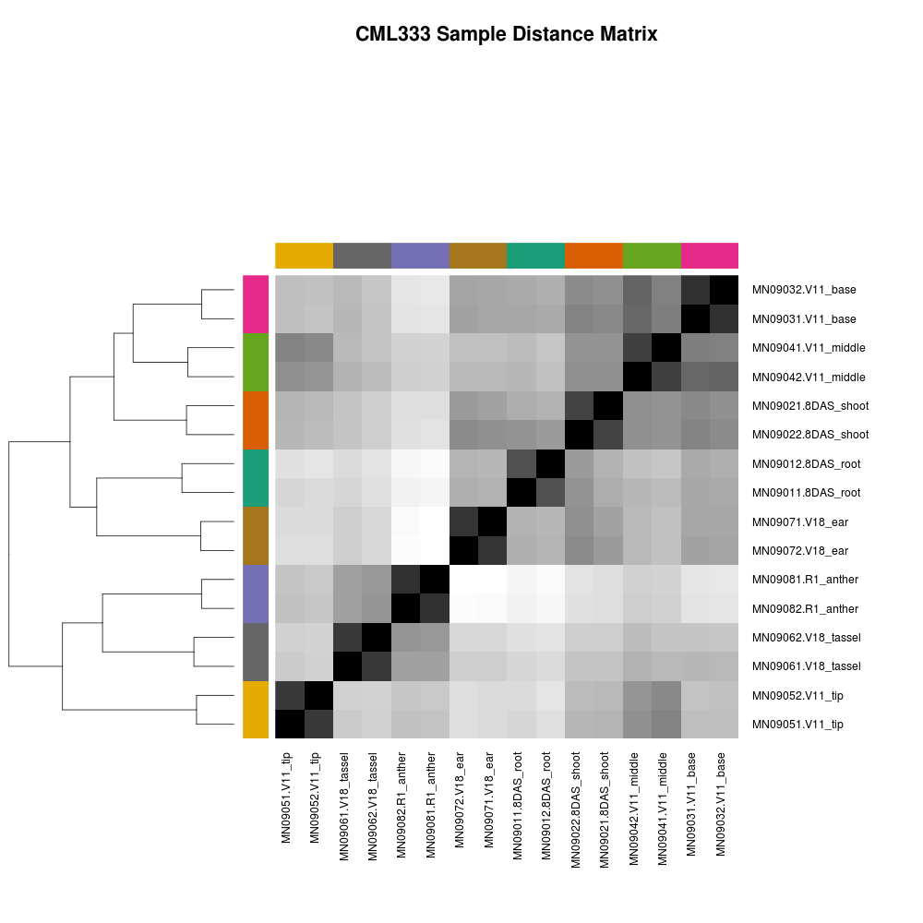
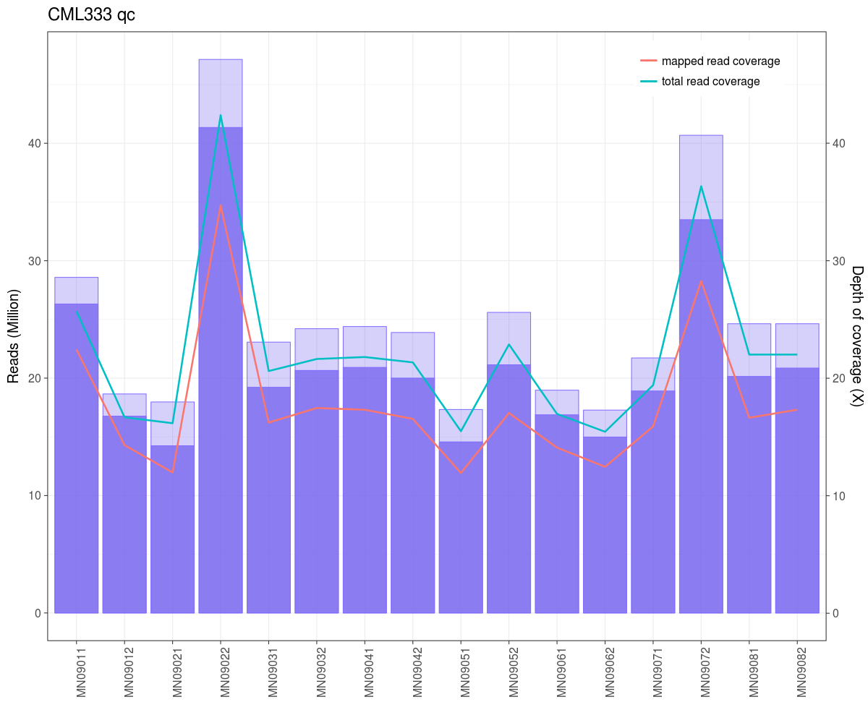

Slide 17

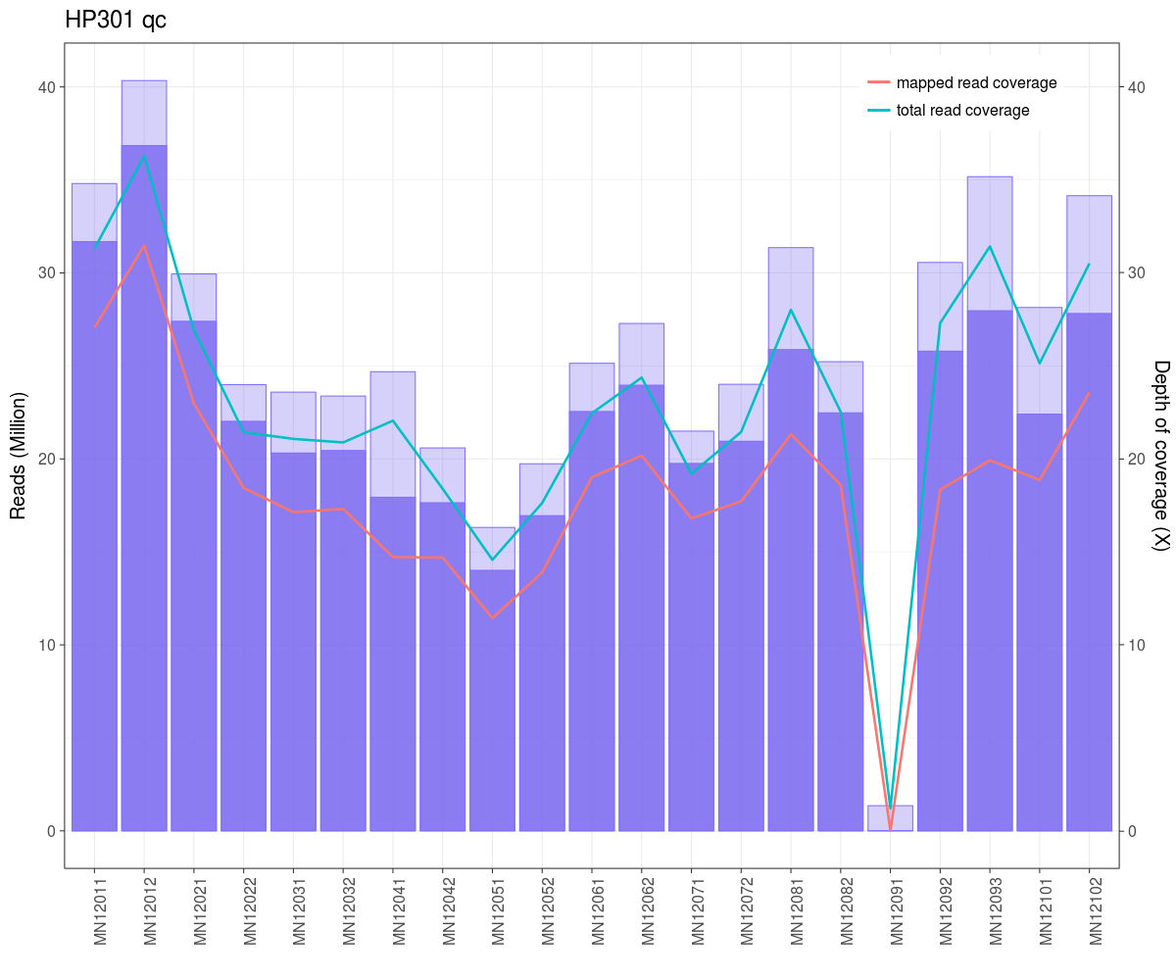

Slide 18
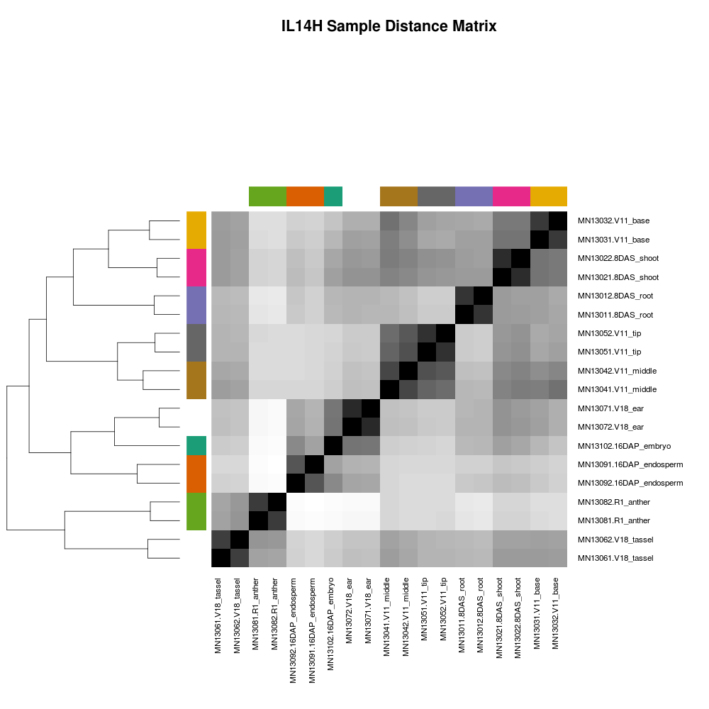
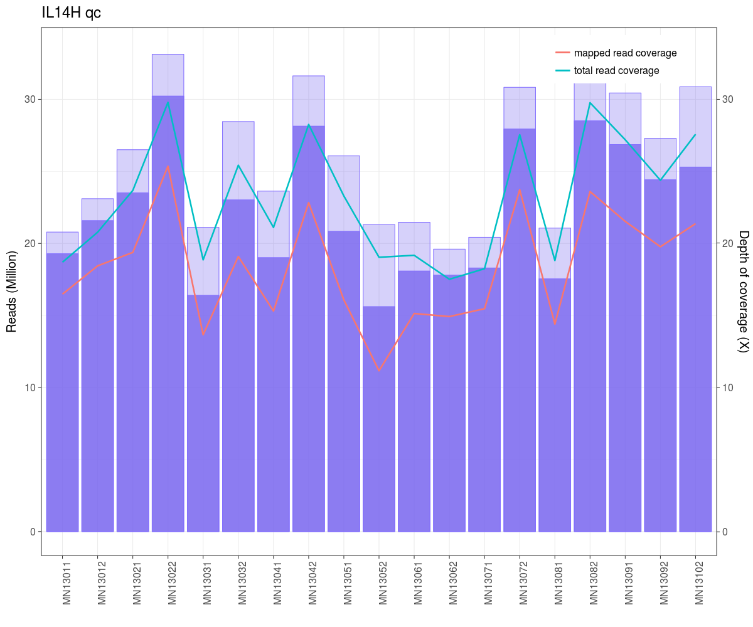

Slide 19
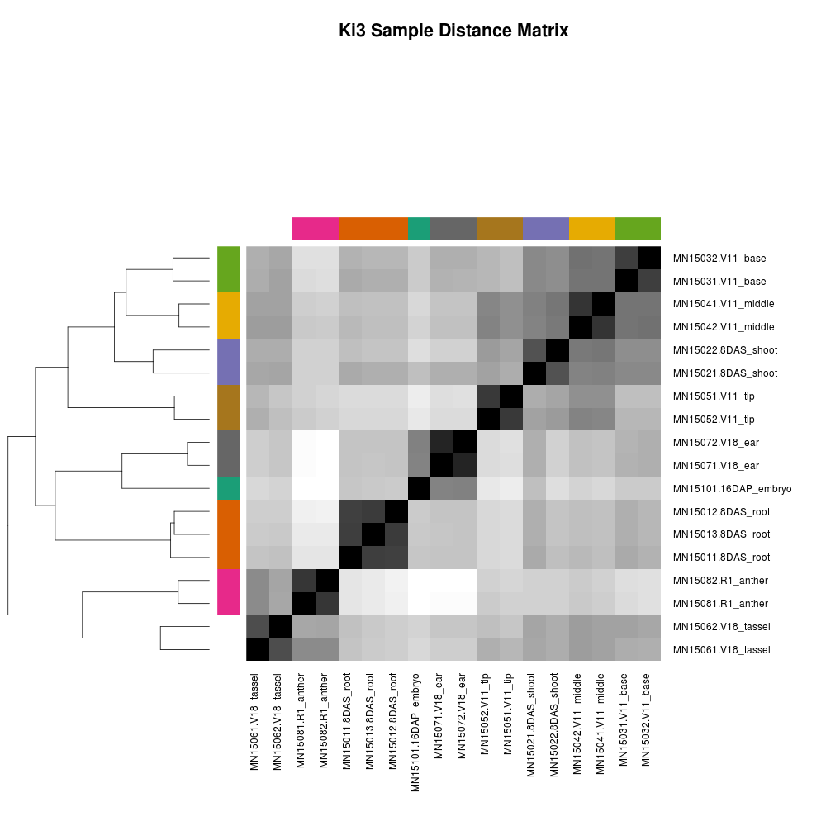
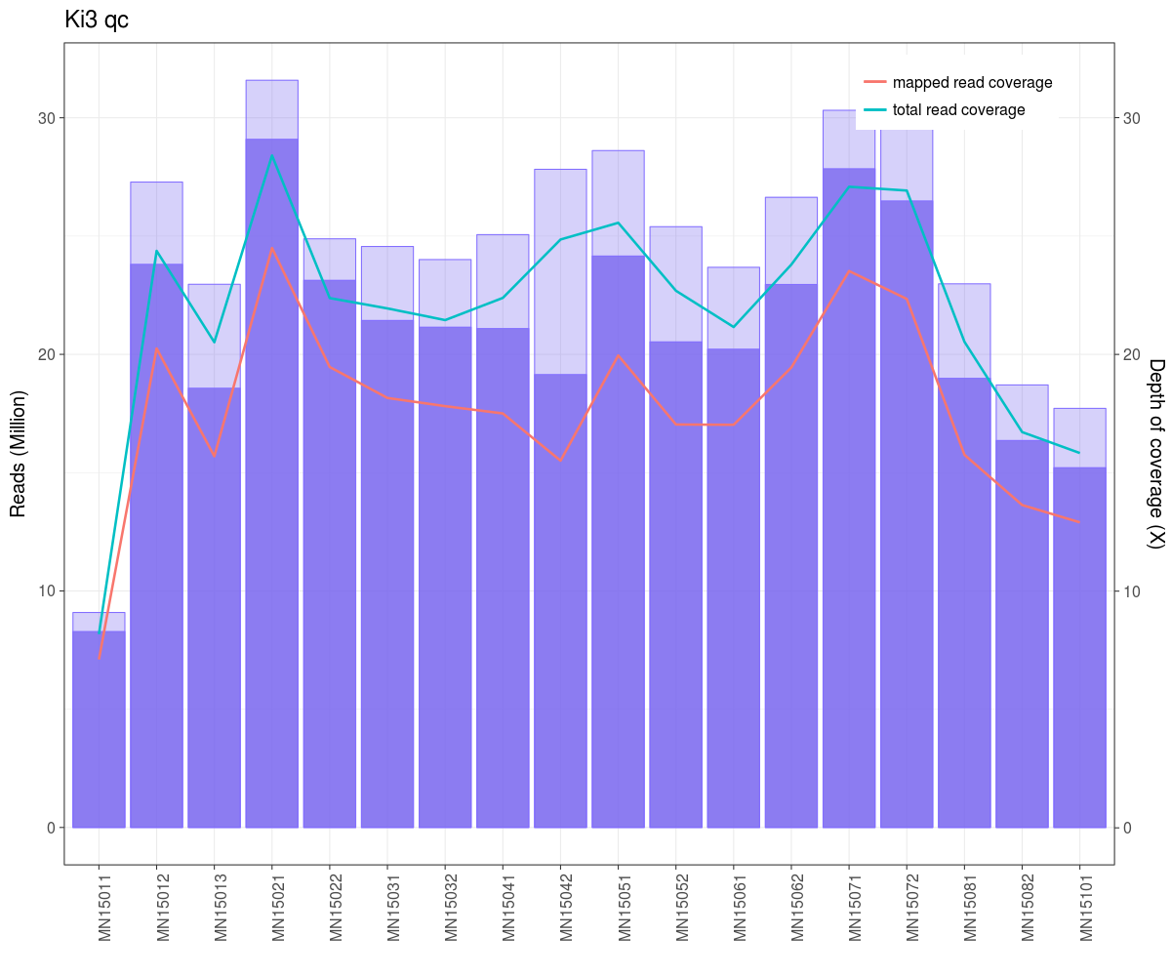

Slide 20
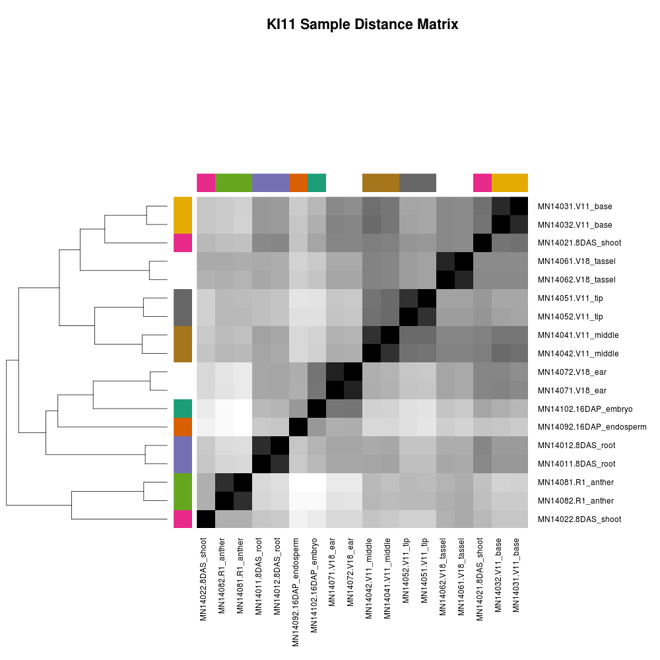
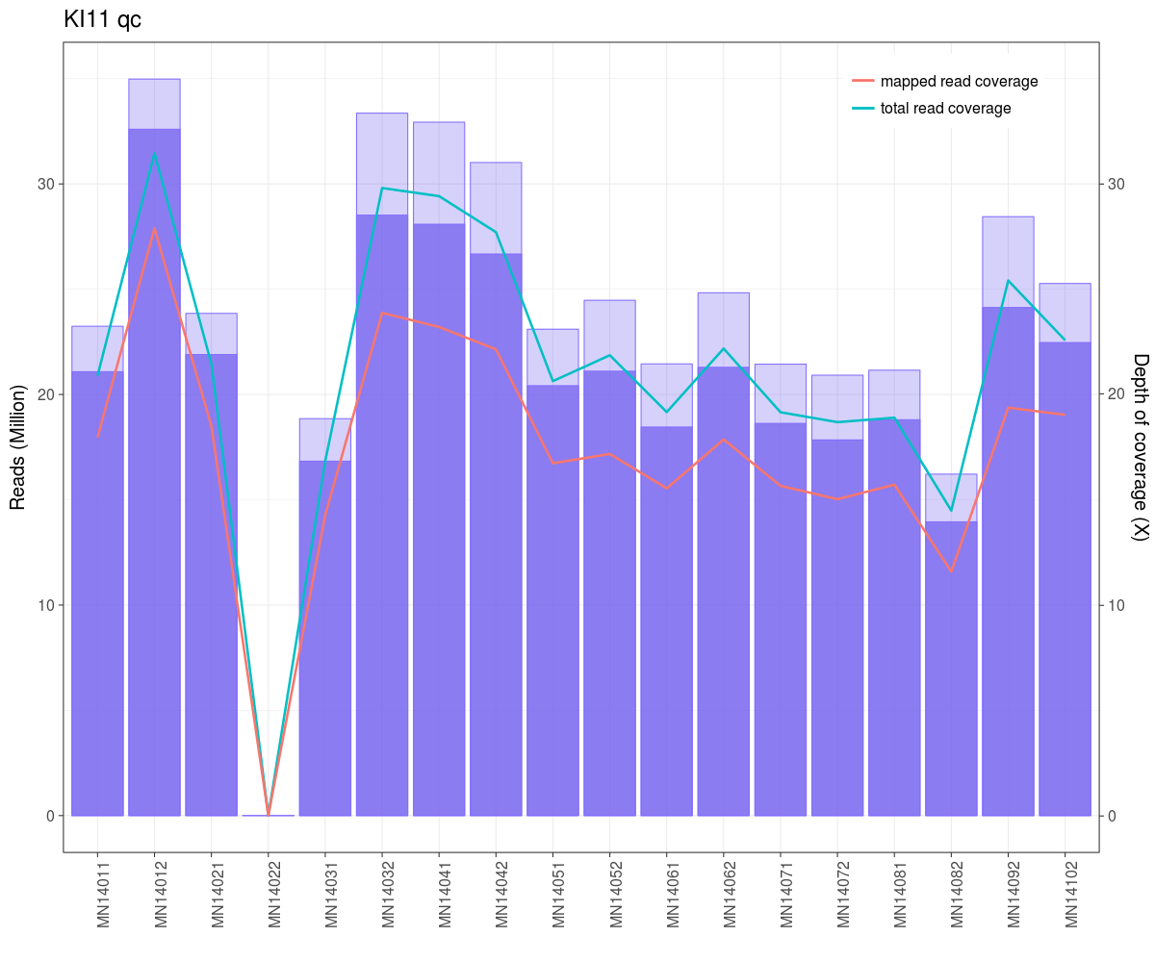

Slide 21
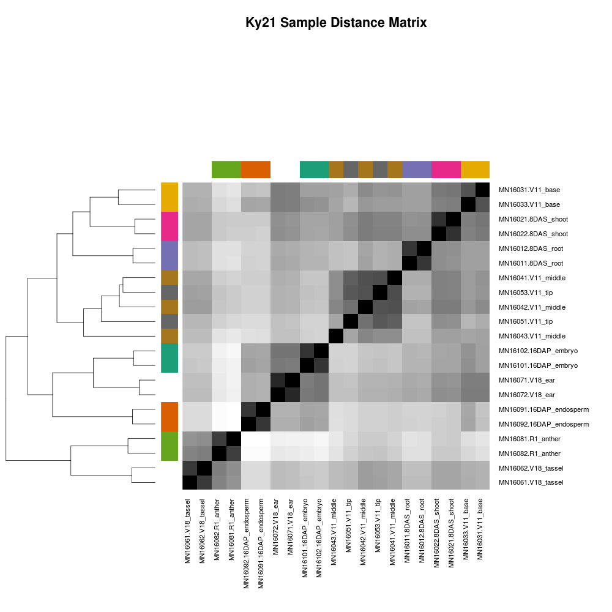
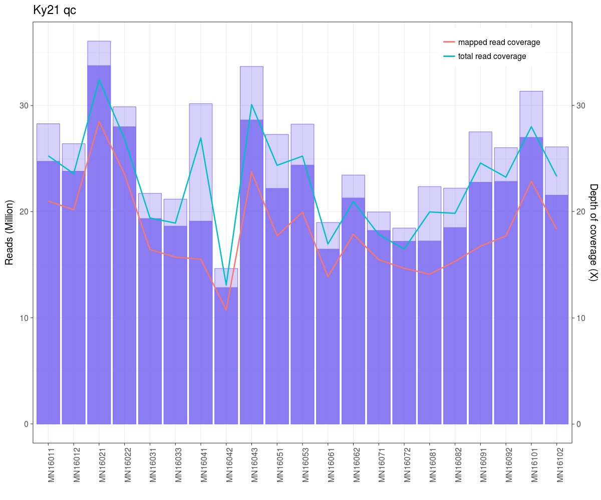

Slide 22
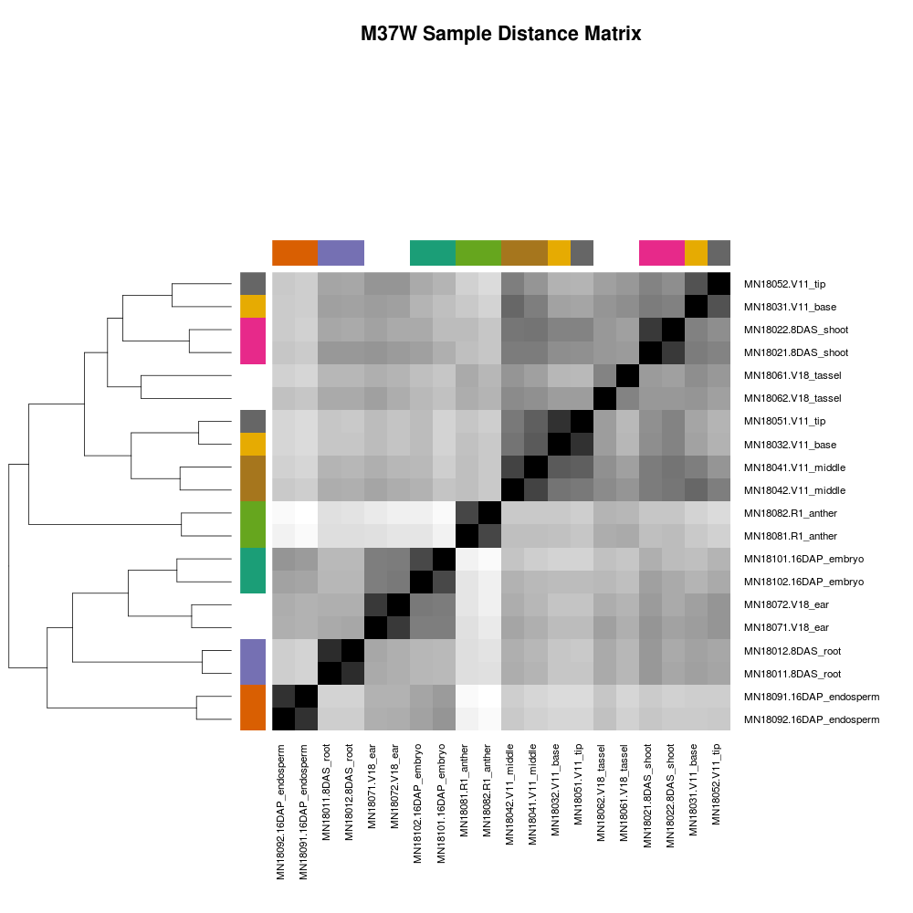
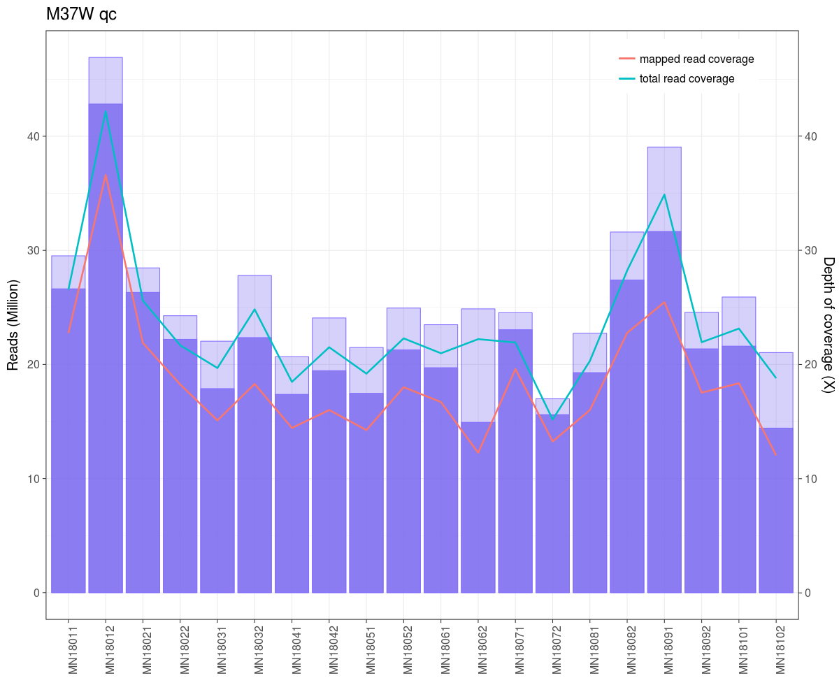

Slide 23
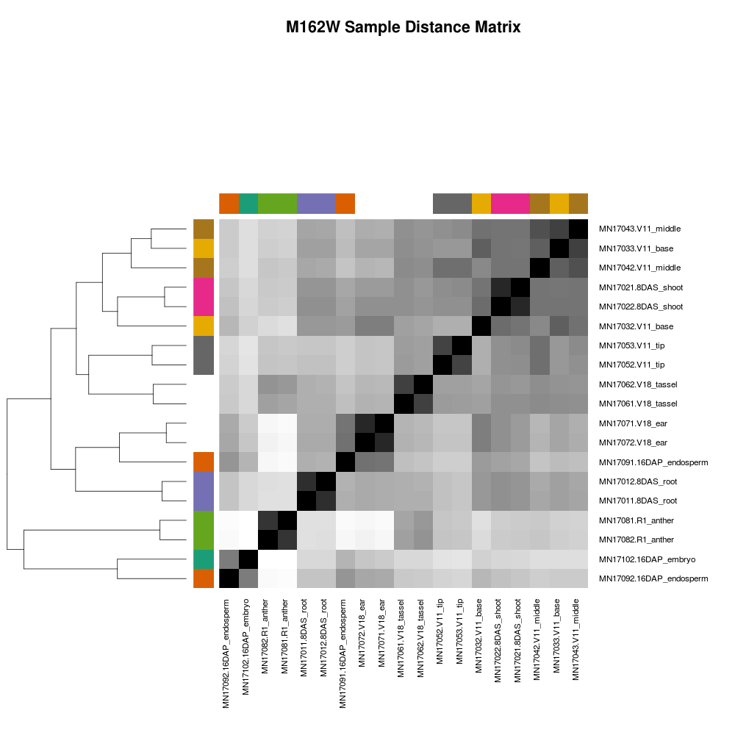
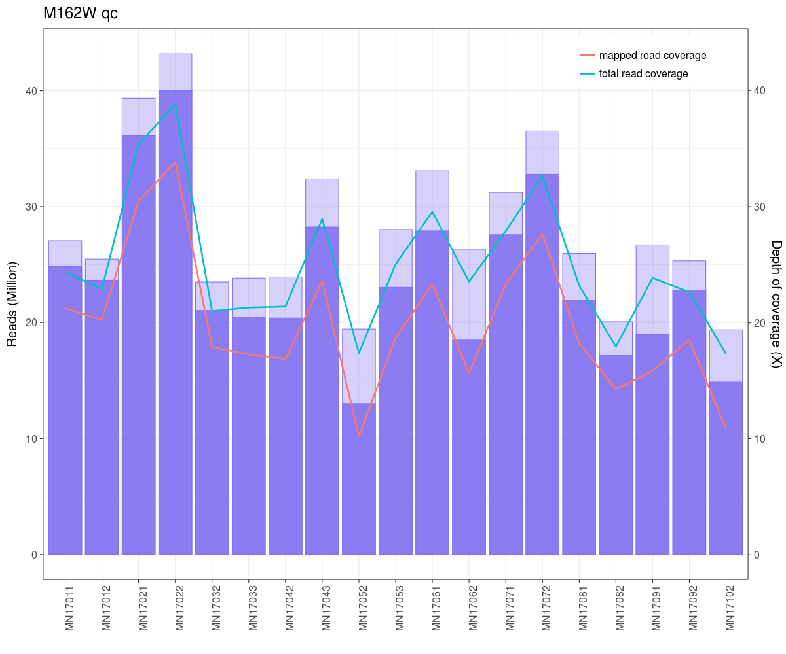

Slide 24
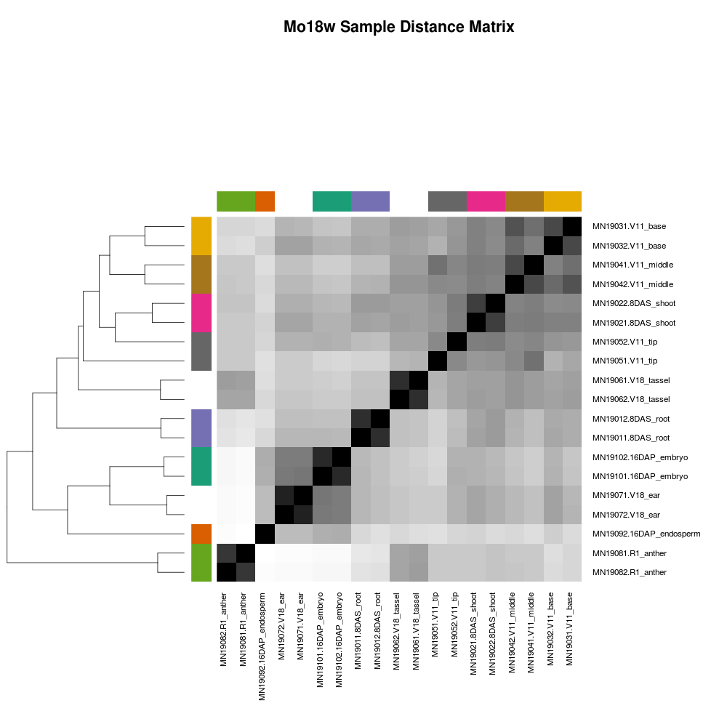
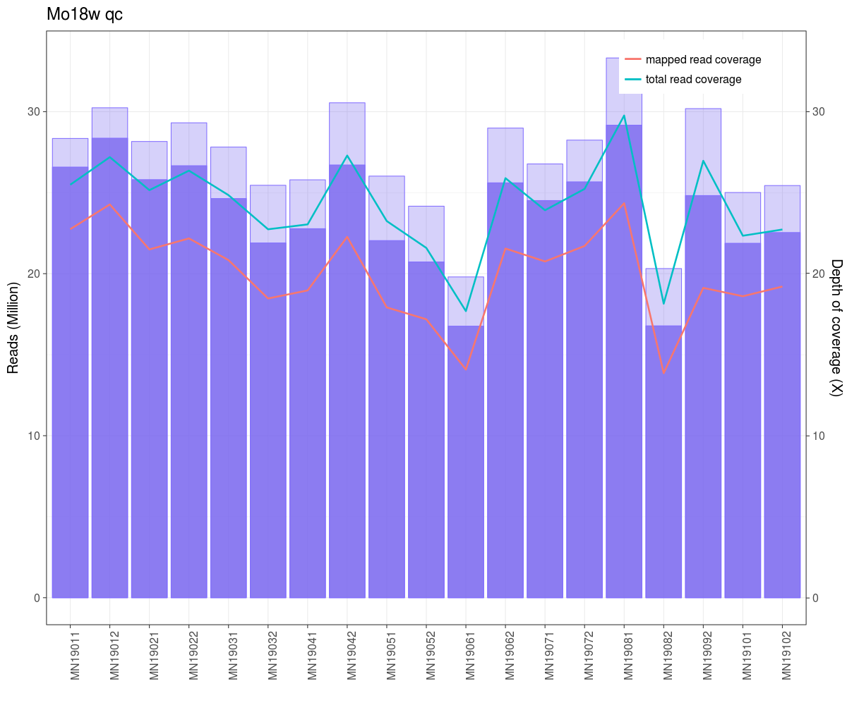

Slide 25
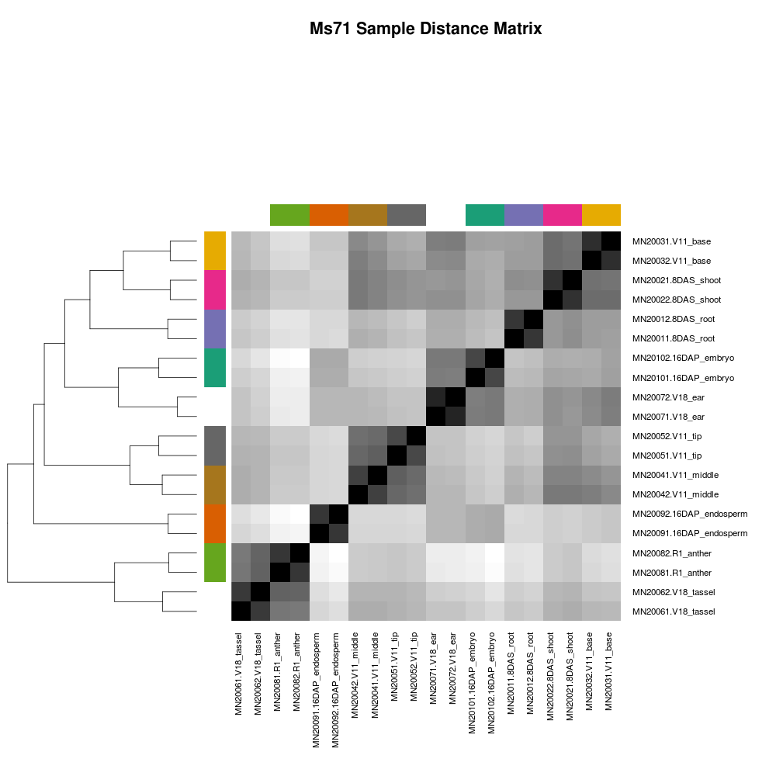
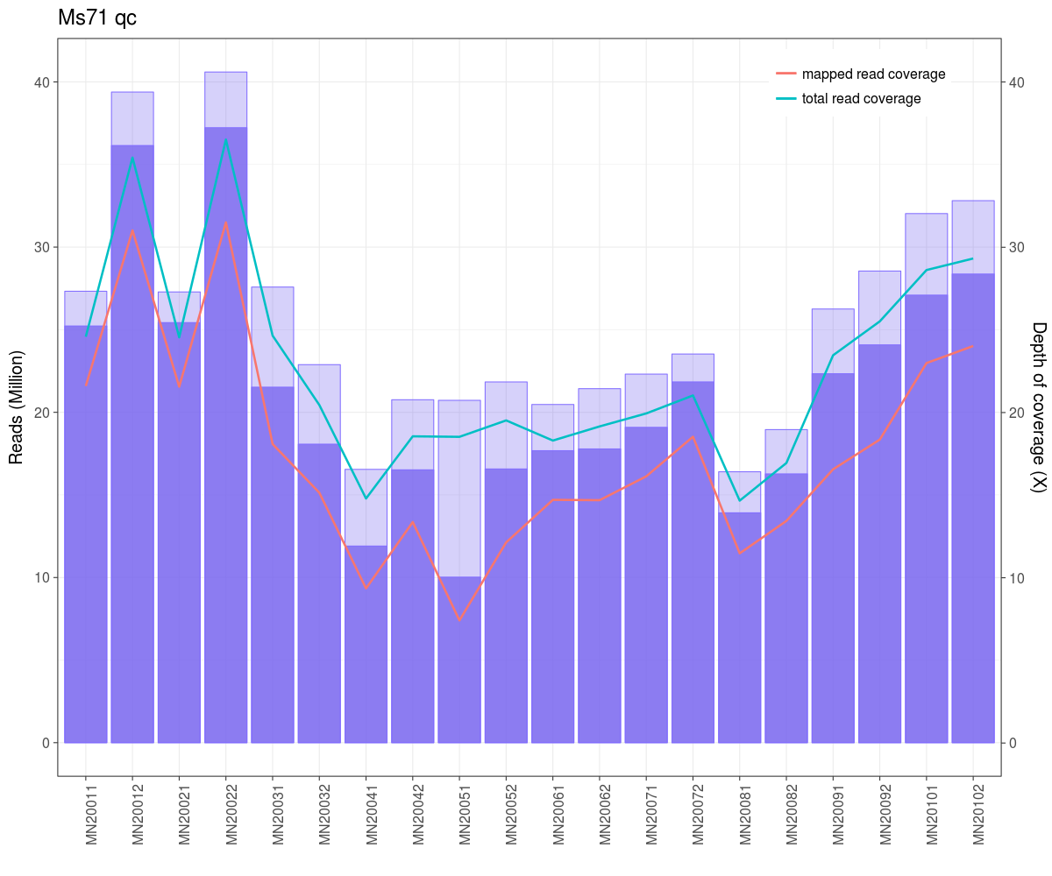

Slide 26
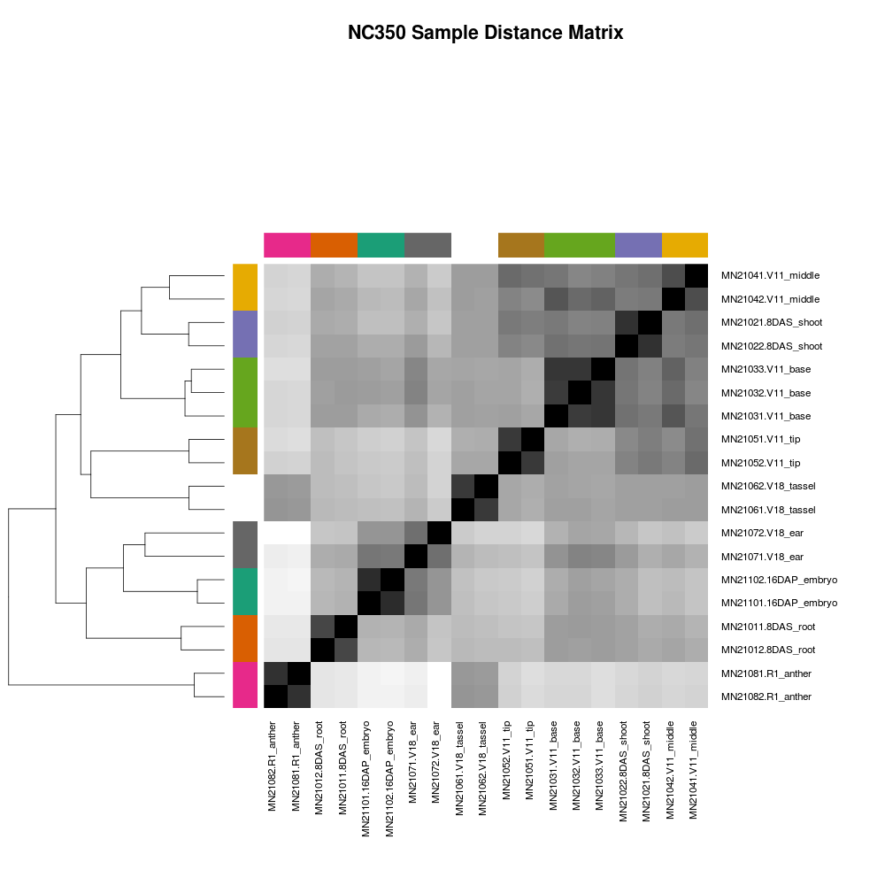
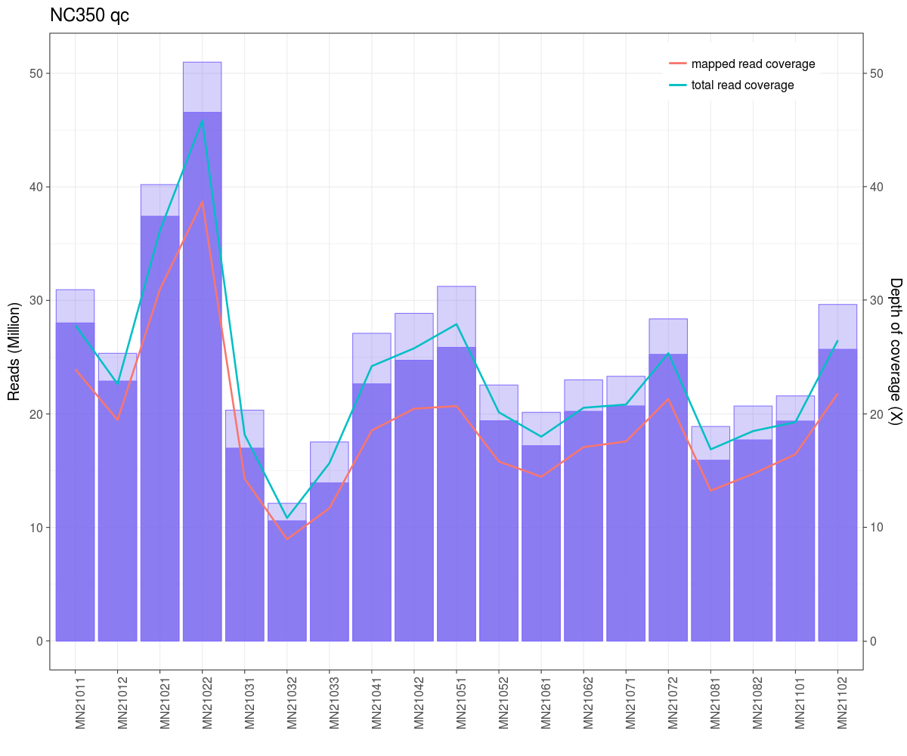

Slide 27
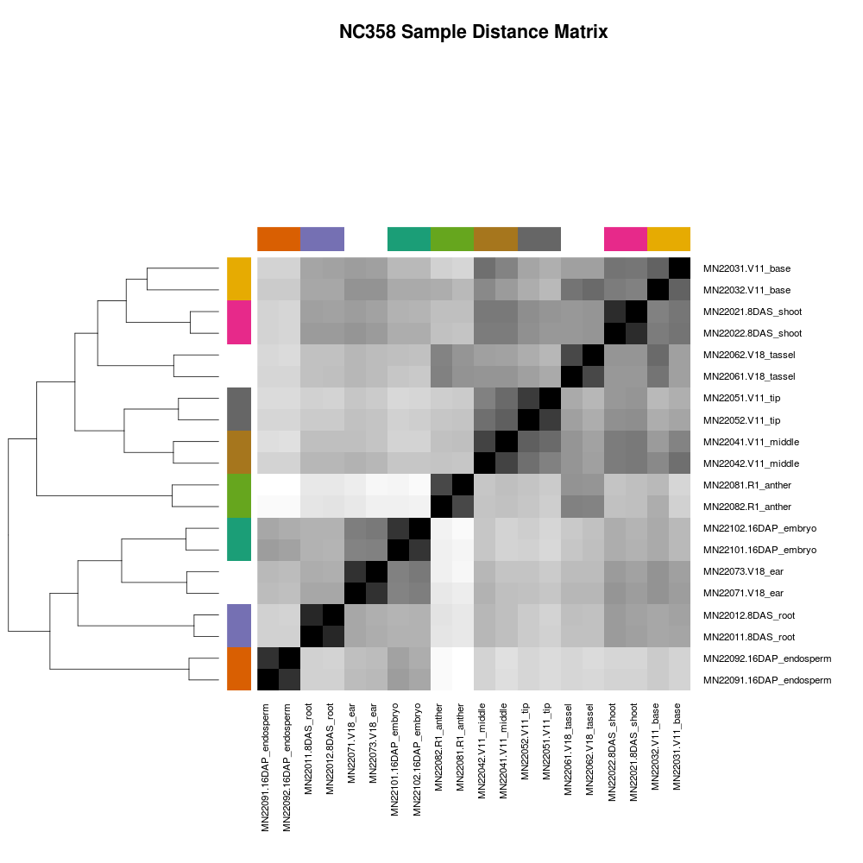
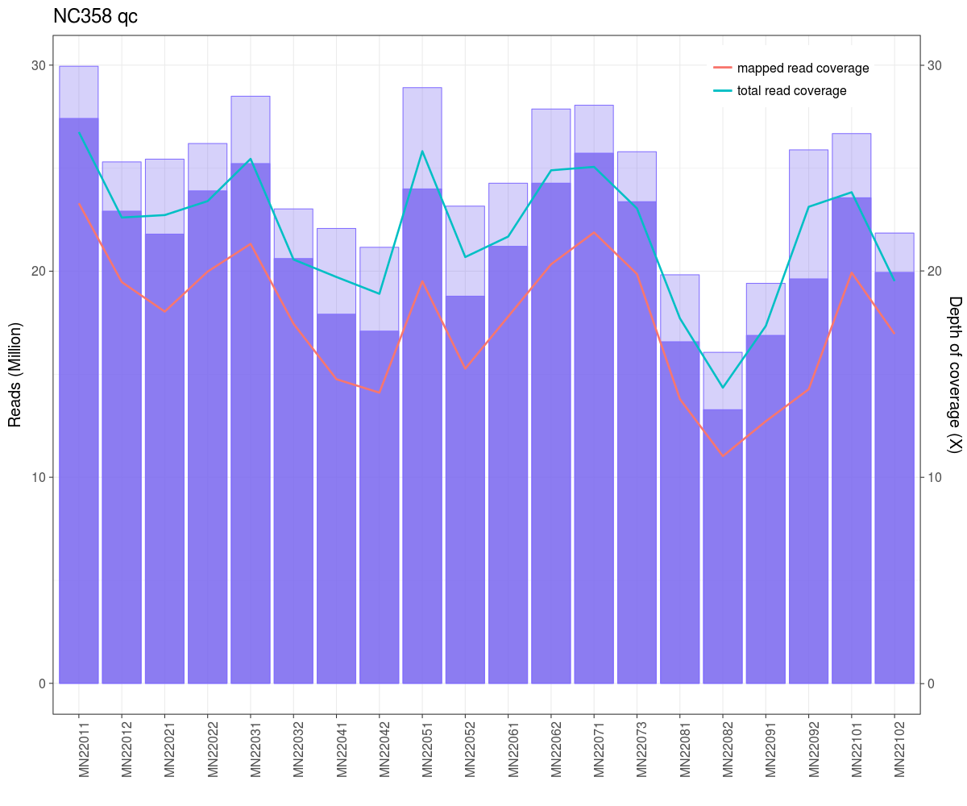

Slide 28
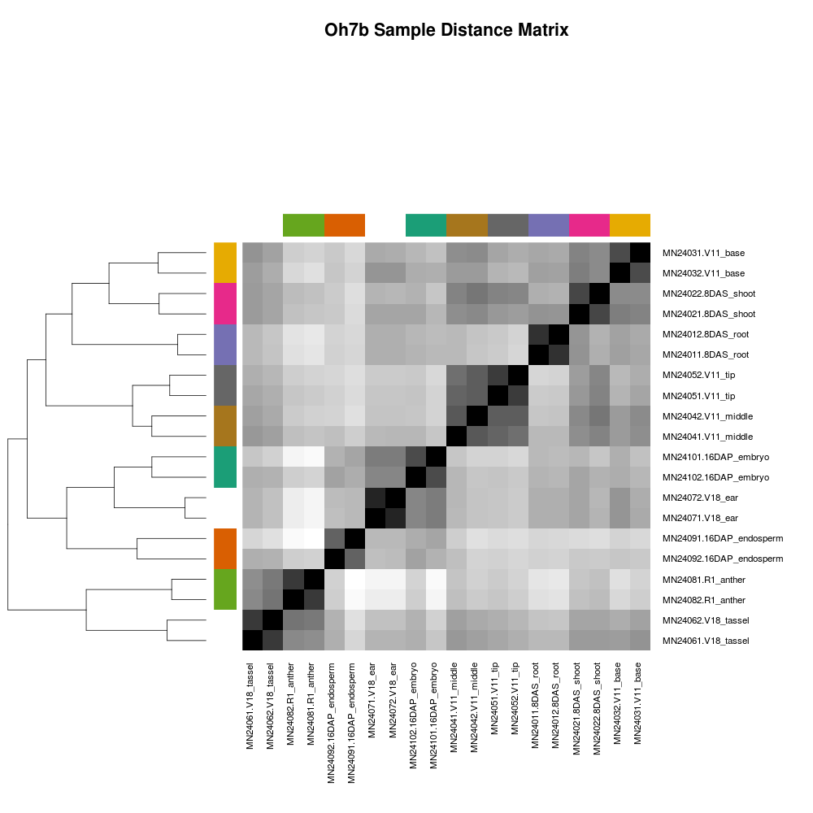


Slide 29



Slide 30



Slide 31



Slide 32



